Slide 1
MPCA LAB MINI PROJECT
PROJECT TITLE: Fire Alarm(Alert) and Extinguishing System.
SECTION: F
STUDENTS NAME & SRN’s:
Serena A. Gomez (PES2UG19CS372)
Roshni Govind (PES2UG19CS339)
Sahil Elton Lobo (PES2UG19CS348)
Sanjana S Murthy (PES2UG19CS364)

Slide 2
PROBLEM STATEMENT
Designing a system to detect fire, as it breaks out and to alert people in the vicinity as well as concerned authorities far away, while deploying immediate measures to reduce the effect of the fire.

Slide 3
INTRODUCTION
Manual fire alarms and sprinkler systems are as reliable as the people that operate them, eliminating the middleman and replacing that with an automated system makes it hassle-free.
In situations of panic like building fires victims do not think to call or alert authorities as they are in shock.
The system that we have built automates the whole fire alarm system that not only triggers an alarm and switches on the sprinkler system, but also alerts authorities without any manual prompts.
Incase the fire is a small one, it also reverts the sprinkler systems once the fire is out. (because we care for the environment too ☺)

Slide 4
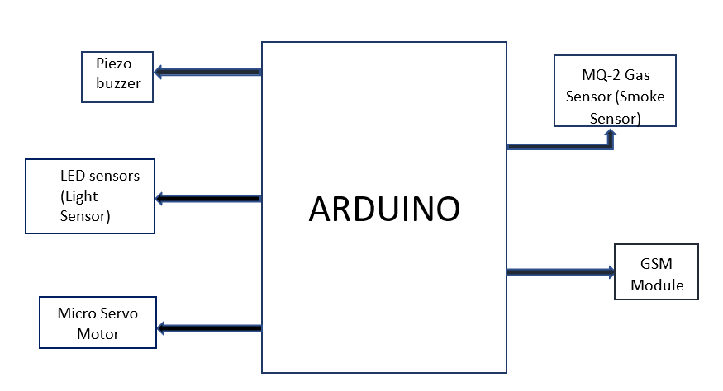
BLOCK DIAGRAM

Slide 5
REQUIRED COMPONENTS
Arduino UNO
GSM 800a module
MQ-2 gas sensor
Micro Servo
DC power source
Piezo Buzzer
3 coloured LEDs
12v adapter
Jumper cables
220ohm resistors

Slide 6
PROJECT DESCRIPTION
This project encapsulates the aspects of hardware as well as software into a single project. Sensors and electrical circuitry have been incorporated with software i.e. code with Arduino used as a segue.
The two libraries used to code are servo.h and softwareserial.h
The MQ-2 smoke sensor is our primary sensor that has been connected to a certain port which has been declared as an input port thus providing the smoke level in the room.
The other sensors have been connected to output ports.
The GSM module is connected to pins 9 and 10 which are PWM(pulse width modulation) enabled pins used for serial communication.
Using logic provided in our code this value is used to trigger a set of condition based instructions depending on the magnitude of the value.

Slide 7
PROJECT DESCRIPTION
When the gas levels are in a safe range the green LED is on and no buzzer rings
As the gas levels rises steadily the yellow LED is turned on and the buzzer rings at a low frequency.
When the gas levels are in a dangerous range the red LED is turned on, the alarm blares at a higher frequency and an SMS alert is relayed from the GSM module to the registered mobile number.
In addition to this, the servo motor connected to the tap controlling the sprinkler system is turned 180 degree to release water to put out the fire.
When the gas level reduces to a safe level again indicating that the fire is out, the servo motor resets to -180 degree to turn the tap off.

Slide 8
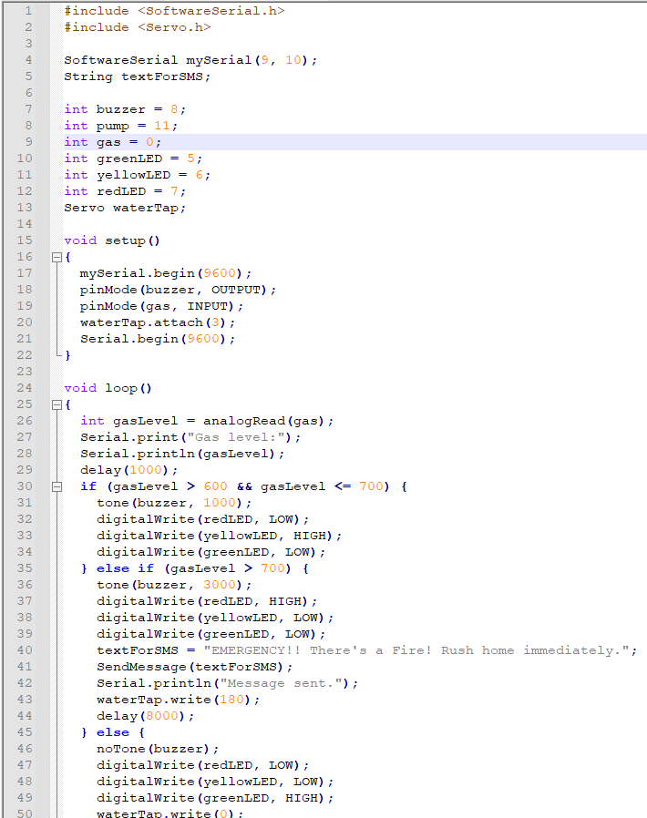
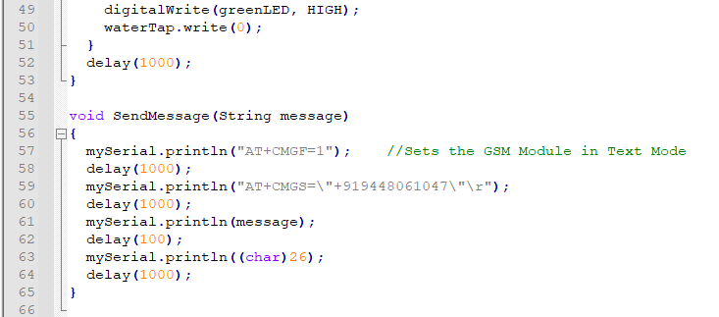
CODE

Slide 9
APPLICATIONS
Can be used in commercial buildings, offices, banks, etc.
Can be used in fires that can be extinguished by water.
Can be altered to fit situations where fires cannot be put out by water(Electrical or Chemical fires), to act as an automated alarm and alert system.

Slide 10
REFERENCES(Website links, Books etc.)
Smoke Detection using MQ-2 Gas Sensor - Arduino Project Hub
DC piezo buzzer volume control - Arduino Project Hub
Servo: Arduino Basics - Arduino Project Hub
Arduino PWM Tutorial - Arduino Project Hub
Interface GSM Module to Arduino - Send and Receive SMS (circuitstoday.com)

Slide 11
THANK YOU

